Slide 1

GOOGLE SEARCH AND COVID19
- Analysis of Google search trends amidst the
corona virus outbreak

Slide 2

IMPACT OF COVID19 ON GOOGLE SEARCH TRENDS
The quick spread of the coronavirus, the latest pandemic, is wreaking havoc on global financial markets, causing capital flight, currency devaluation and threatening a global economic recession. Google search interest is also very high around the world. COVID19 related searches now are most popular searches on Google

Slide 3

01.
SEARCH TOPIC: FINANCE
- Finance word search trends in Canada

Slide 4

IMPACT OF CORONAVIRUS ON GOOGLE SEARCH tRends
Interest over time
ECONOMICS
CIBC
Since the COVID 19 outbreak, there has been a record high google search on various Finance topics
Biggest increase in the search frequency over the last one year period in Economics relate queries
CIBC has a search score of 42 (4th highest) after RBC, TD And BMO

Slide 5
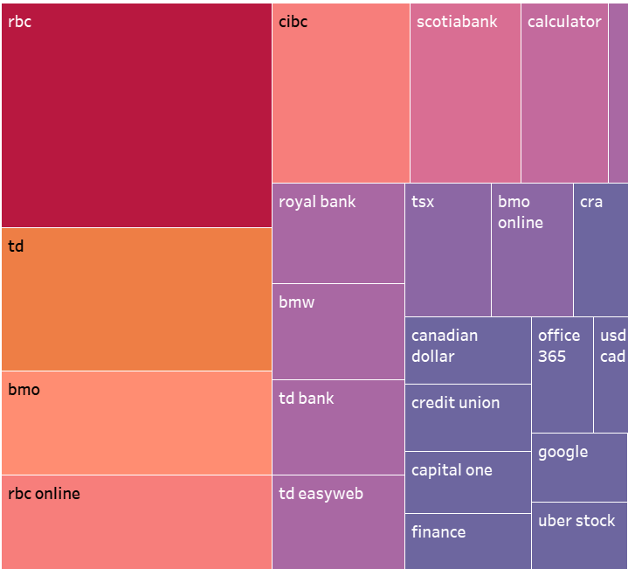
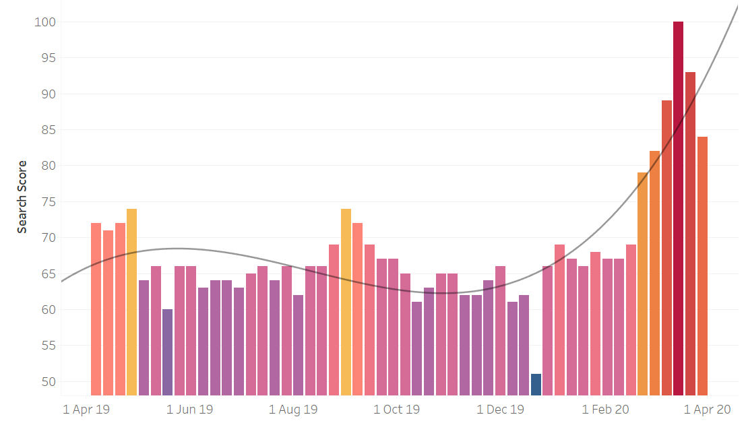
TOP SEARCHES ON GOOGLE
* The most popular topics. Scoring is on a relative scale where a value of 100 is the most commonly searched topic and a value of 50 is a topic searched half as often as the most popular term, and so on

Slide 6
02.
SEARCH TOPIC: CIBC

Slide 7
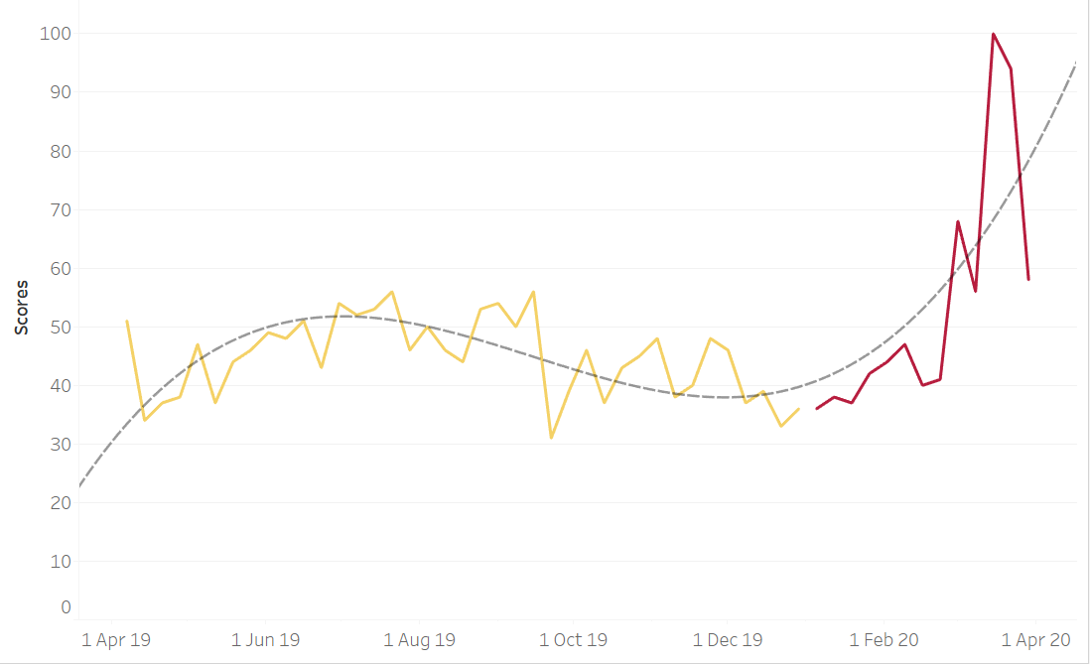
CIBC SEARCH TREND SINCE 2019
2019
2020
Highest search score is observed during the pandemic outbreak

Slide 8
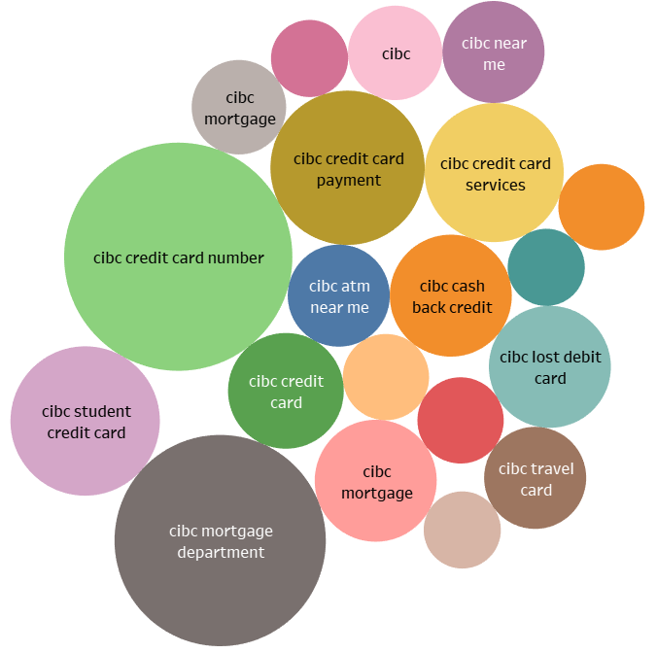
TOP SEARCHES
Mortgage deferral CIBC | +350%
CIBC Mortgage Dept | +300%
CIBC Credit card payment | +160%
CIBC lost debit card | +100%
CIBC near me | +70%
CIBC travel card | +70%
The data shows increase in number of searches for respective topics. Mortgage related searches have tremendously increased during the pandemic outbreak.

Slide 9
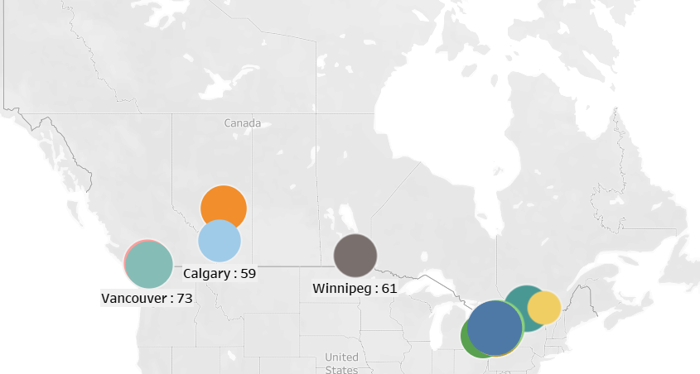
CITIES WITH THE HIGHEST search scores
CITIES | SCORE
Brampton | 100
Mississauga | 98
Markham | 94
Toronto | 86
Surrey | 73
Vancouver | 73
Ottawa | 71
Edmonton | 69
London | 65
Hamilton | 63
Winnipeg | 61
Calgary | 59
Montreal | 37

Slide 10

ADDITIONAL FACTS
1. Telecommuting has become the norm for most companies 2. COVID-19 searches spike early in the morning and late at night 3. Streaming platforms have decided to slightly decrease their video quality in response to an increased demand (due to home isolation) to ensure that videos can play properly 4. Many Advertisers note 10-25% lower conversion rates from their ads

